Slide 1
From Sketch to Reality: Generating web page from a sketch
Xinqi Li, Peilin Hao, Yinan Zhang

Slide 2
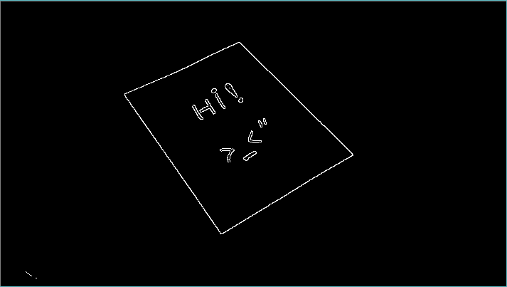
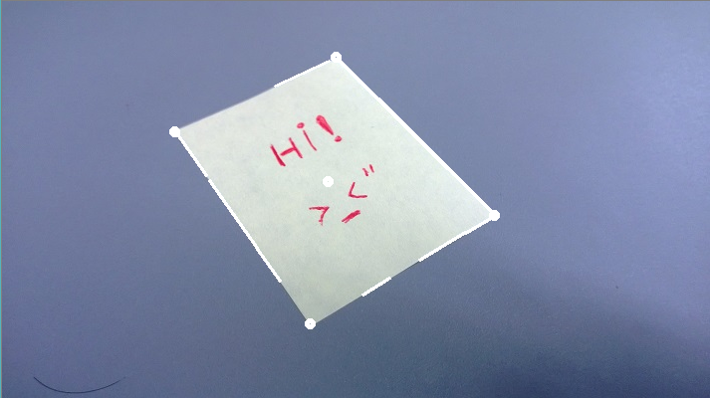

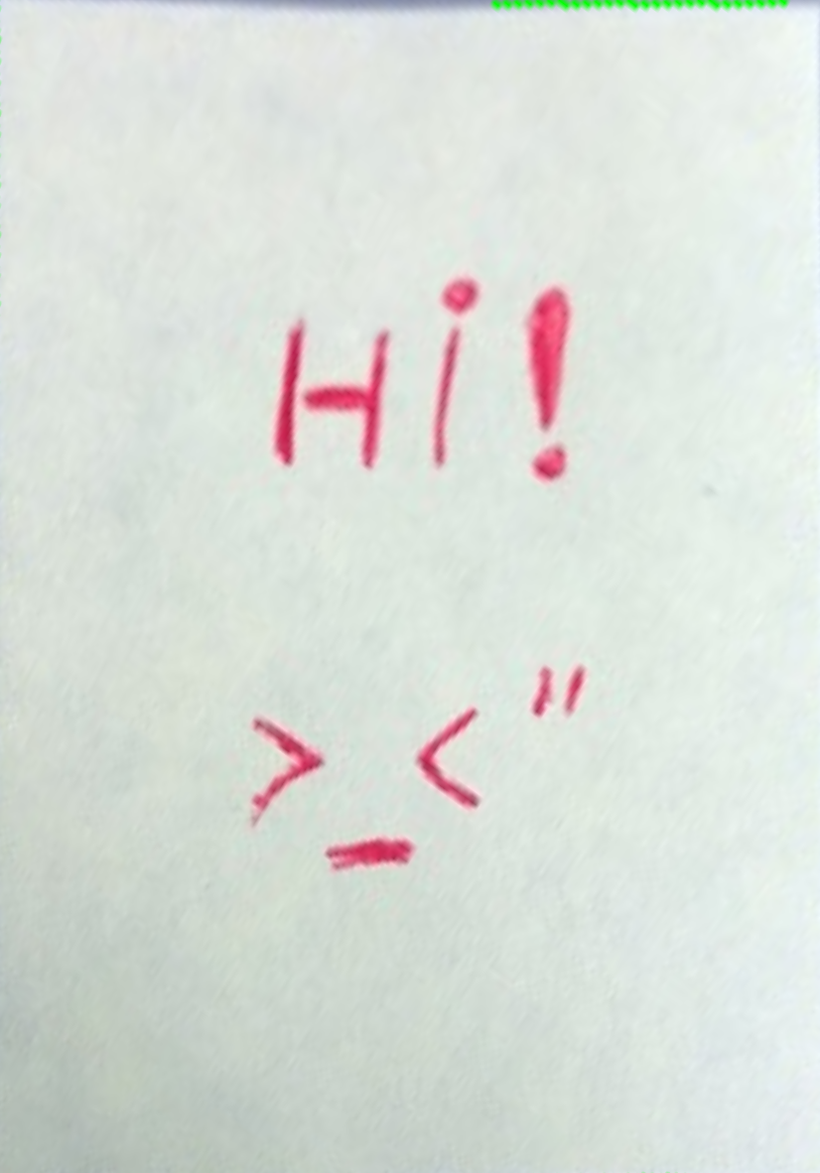
Perspective Correction
Get the edge map
Detect lines with Hough Transform[1]
Get points of corners of a paper
Construction transformation matrix[2]
Apply perspective transformation
References:
[1] Hough Line Transform: http://docs.opencv.org/doc/tutorials/imgproc/imgtrans/hough_lines/hough_lines.html
[2] Perspective Transform Estimation http://xenia.media.mit.edu/~cwren/interpolator/

Slide 3
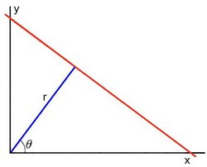
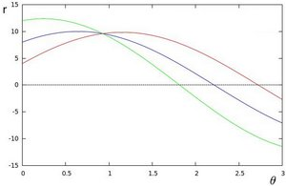
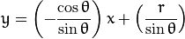
Hough Transform
-
For a point , line family:
For every point in the image:
Find its family of lines, get sinusoid curves
If the curves of two points intersect in the
plane - , they belong to a same line:
A line can be detected by finding the number of intersections between curves.
Keep tracking of the intersection between curves of every point in the image. If the number of intersections is above some threshold, then declares it as a line.
Hough Line Transform: http://docs.opencv.org/doc/tutorials/imgproc/imgtrans/hough_lines/hough_lines.html

Slide 4
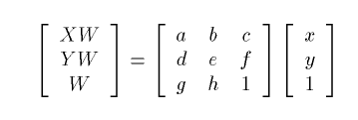
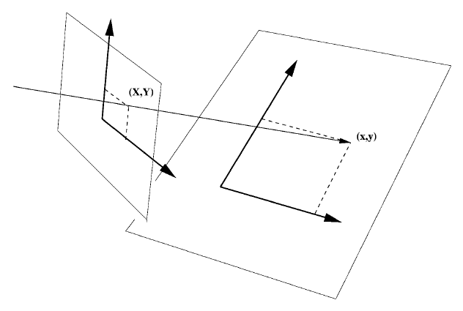
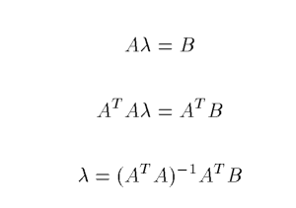
Constructing the transformation matrix
Equation:
Matrix form:
Perspective Transform Estimation http://xenia.media.mit.edu/~cwren/interpolator/

Slide 5
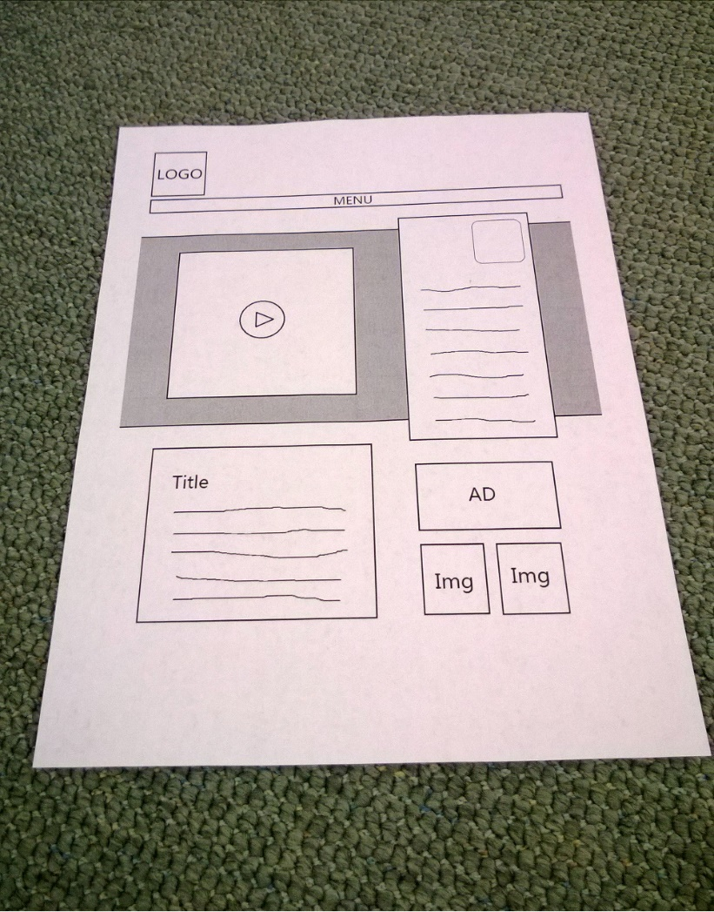
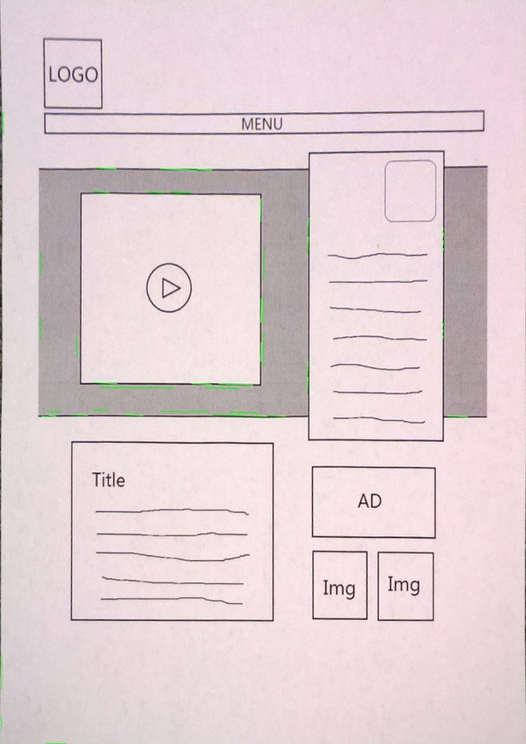
Perspective Correction Result
Source
Result

Slide 6

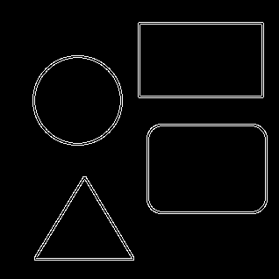
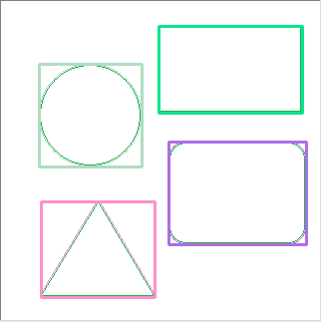
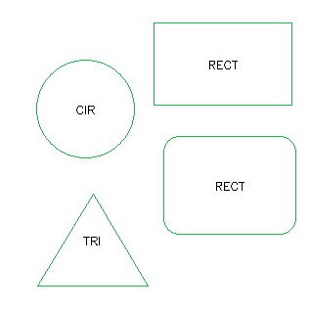
Shape Detection
Get edge image
Find contours
Approximate a curve or a polygon[1]
Determine the shape based on
vertices[2]
References:
[1]Suzuki, S. and Abe, K., Topological Structural Analysis of Digitized Binary Images by Border Following. CVGIP 30 1, pp 32-46 (1985)
[2] Ramer–Douglas–Peucker algorithm: http://en.wikipedia.org/wiki/Ramer-Douglas-Peucker_algorithm

Slide 7
Ramer–Douglas–Peucker Algorithm
Condition: given a curve composed of line segments
Purpose: find a similar curve with fewer points
The new curve consists of the subset of original points.
Key Def.:
“dissimilar”=DistanceMAX(original, simplified)

Slide 8
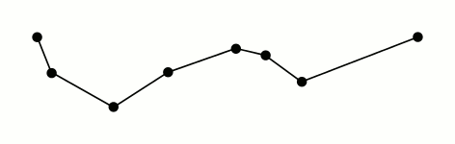
How it works--Recursion
Define a distance dimension ε
Begin with the first and the last points→ PS & PE
Pf: furthest point from LineSE→Df=distance(Pf, LineSE)
If(Df<ε) draw a new simplified line LineSE, processed other points
else PE= Pf go to 3 until all the points are processed

Slide 9
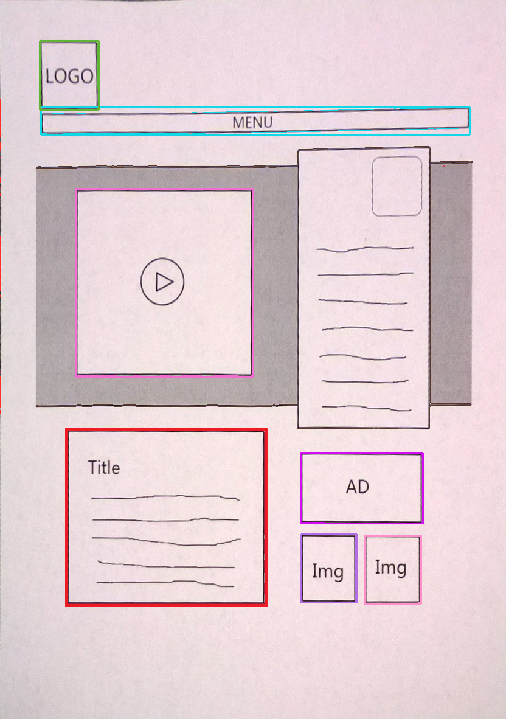
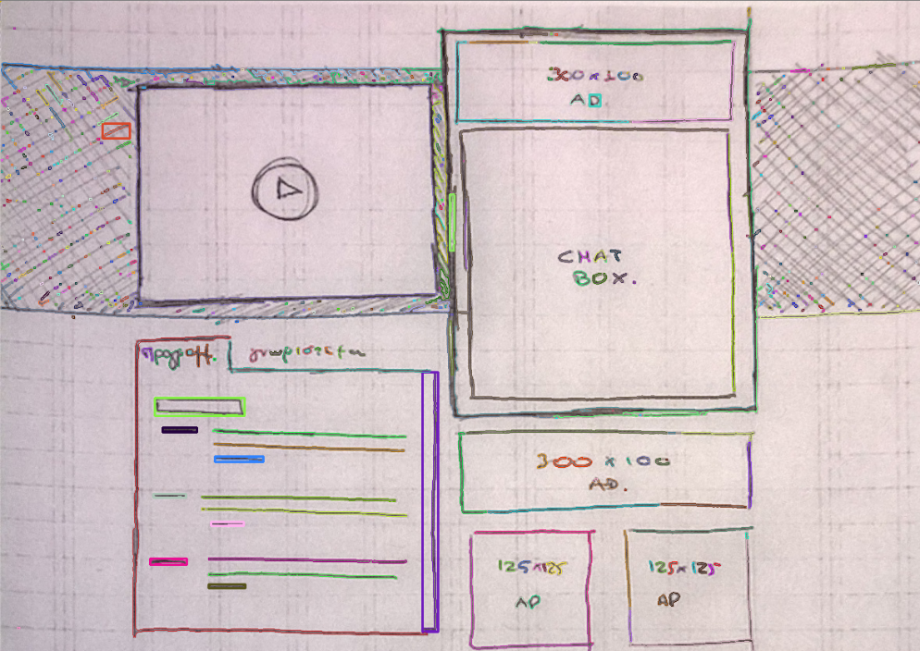
Shape Detection Result:
Bad Result with hand drawing
Input
Result

Slide 10
OCR(Optical Character Recognition)
PyTesser is an Optical Character Recognition module for Python.[1]
Input: image or image file
Output: string
PyTesser uses the Tesseract OCR engine[2], converting images to an accepted format and calling the Tesseract executable as an external script. [1]

Slide 11
Python Imaging Library (PIL)
PIL adds image processing capabilities to your Python interpreter and this library supports many file formats, and provides powerful image processing and graphics capabilities.[3]
Reference:
[1] http://code.google.com/p/pytesser/
[2] http://code.google.com/p/tesseract-ocr/
[3] http://www.pythonware.com/products/pil/

Slide 12
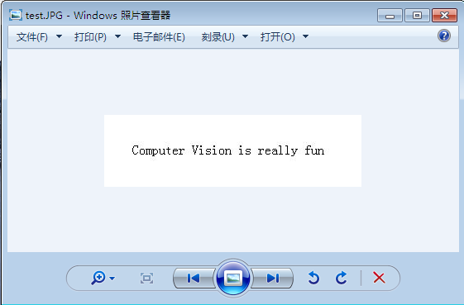
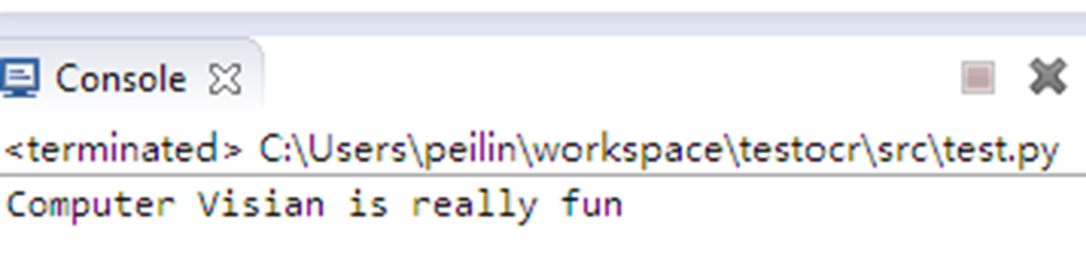
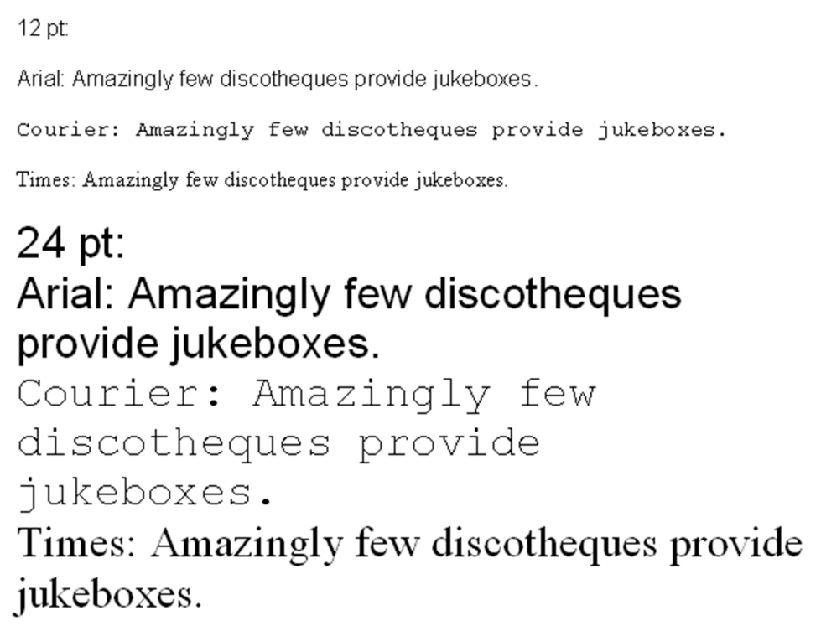
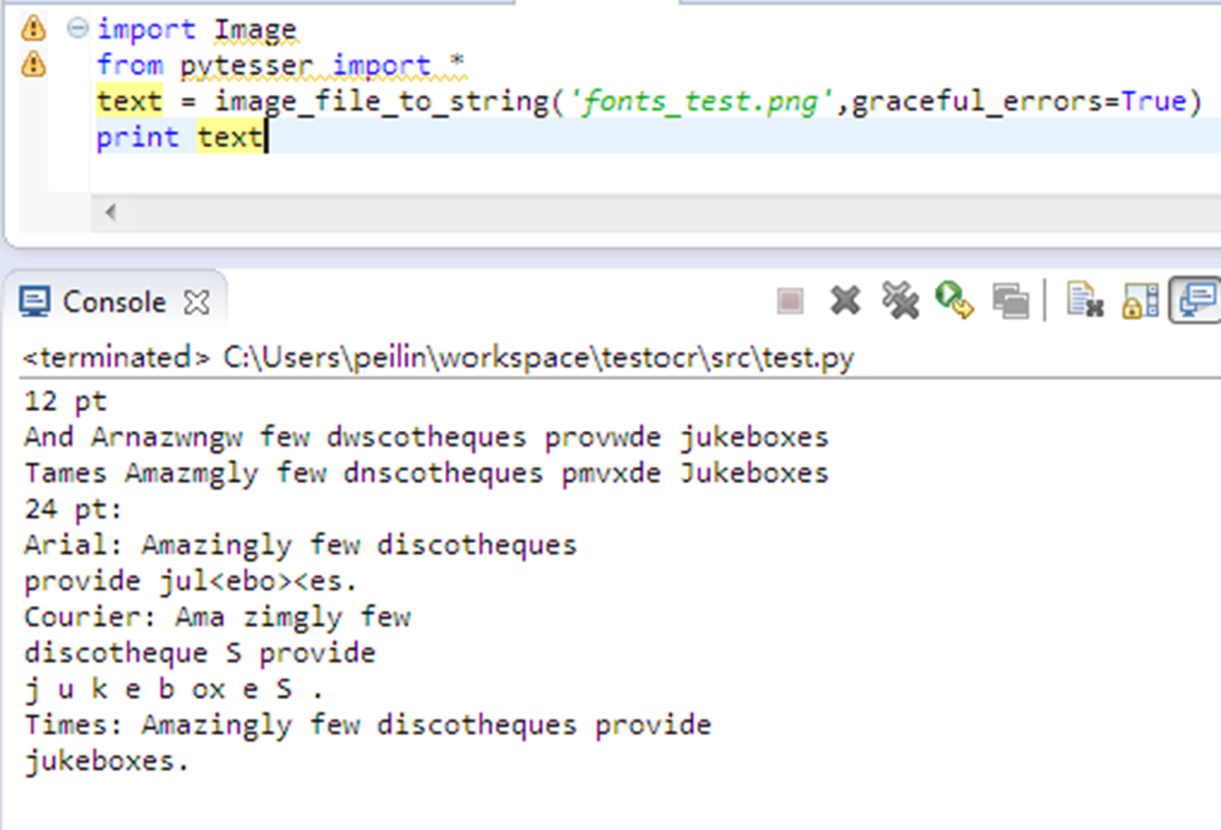
OCR Result：

Slide 13
What’s next?
Generate HTML code
Find images the designer want with a little sketch
LEE, Y., ZITNICK, C., AND COHEN, M. 2011. ShadowDraw:real-time user guidance for freehand drawing. ACM Trans.Graph. (Proc. SIGGRAPH) 30, 4, 27:1–27:10.
Eitz, Mathias, James Hays, and Marc Alexa. "How do humans sketch objects?." ACM Transactions on Graphics (TOG) 31.4 (2012): 44.
Shrivastava, Abhinav, et al. "Data-driven visual similarity for cross-domain image matching." ACM Transactions on Graphics (TOG). Vol. 30. No. 6. ACM, 2011.

